Slide 1
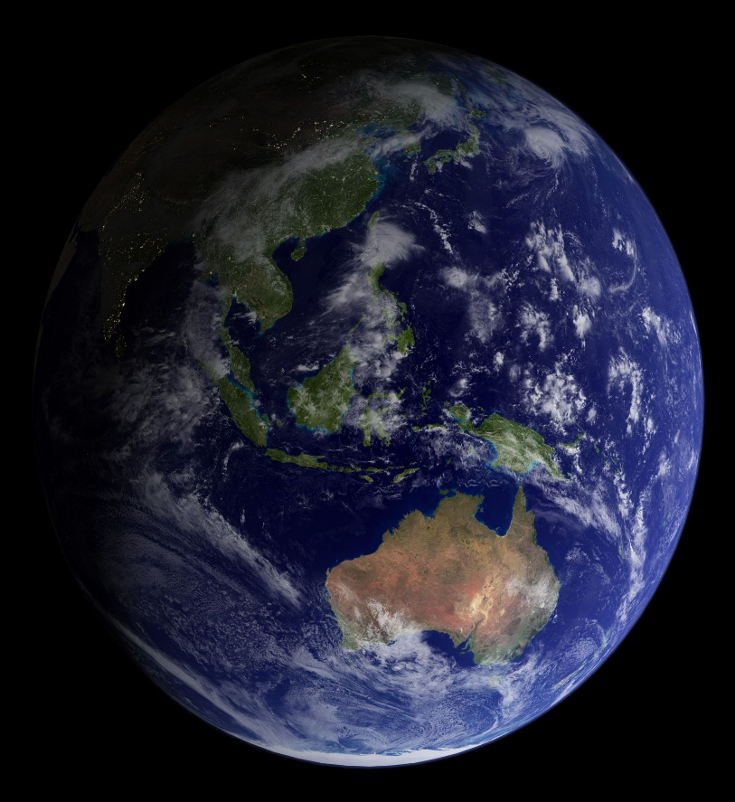
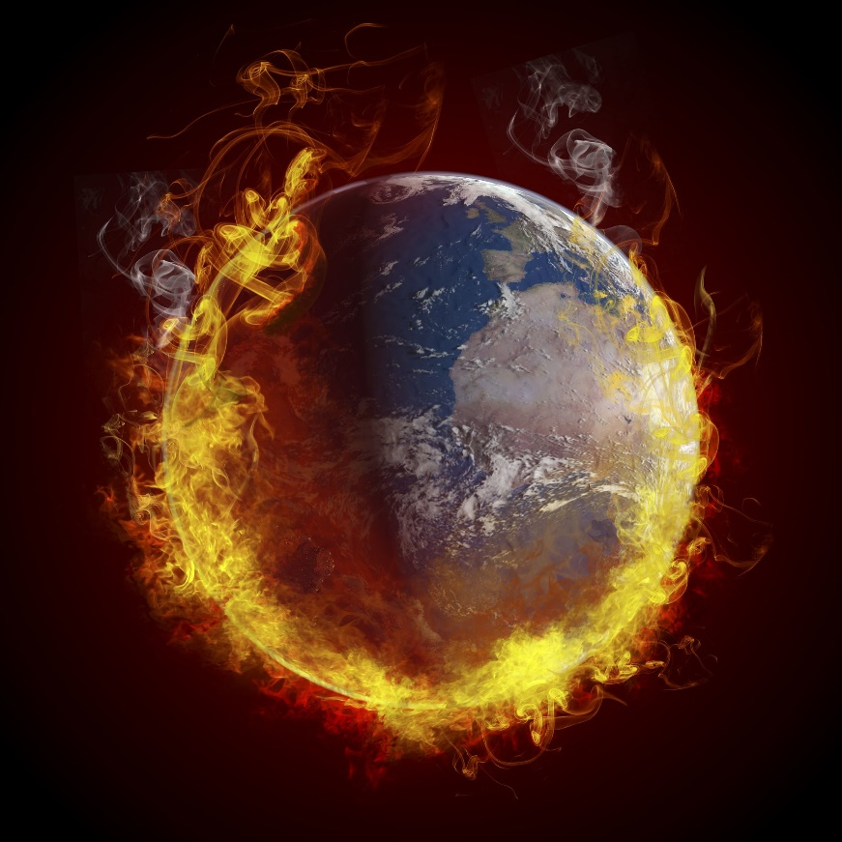
Stop Global Warming

Slide 2
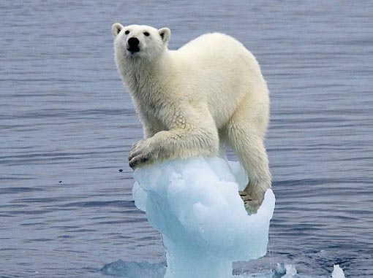
What is Global Warming?
The Earth`s average temperature is rising constantly.
Human activity is the main cause of global warming.

Slide 3
Types of Pollutions
Air Pollution
Water Pollution
Land Pollution
Noise Pollution

Slide 4
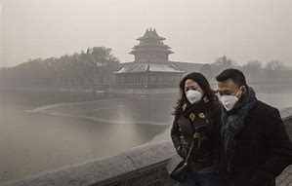
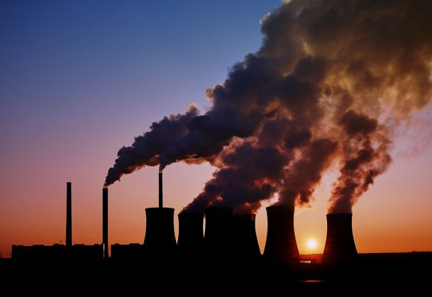
Air Pollution
Air Pollution is caused by smoke and CO₂.
It pollutes the air making it harder to breathe.
The causes of air pollution include asthma, headache and breathing problems etc.

Slide 5
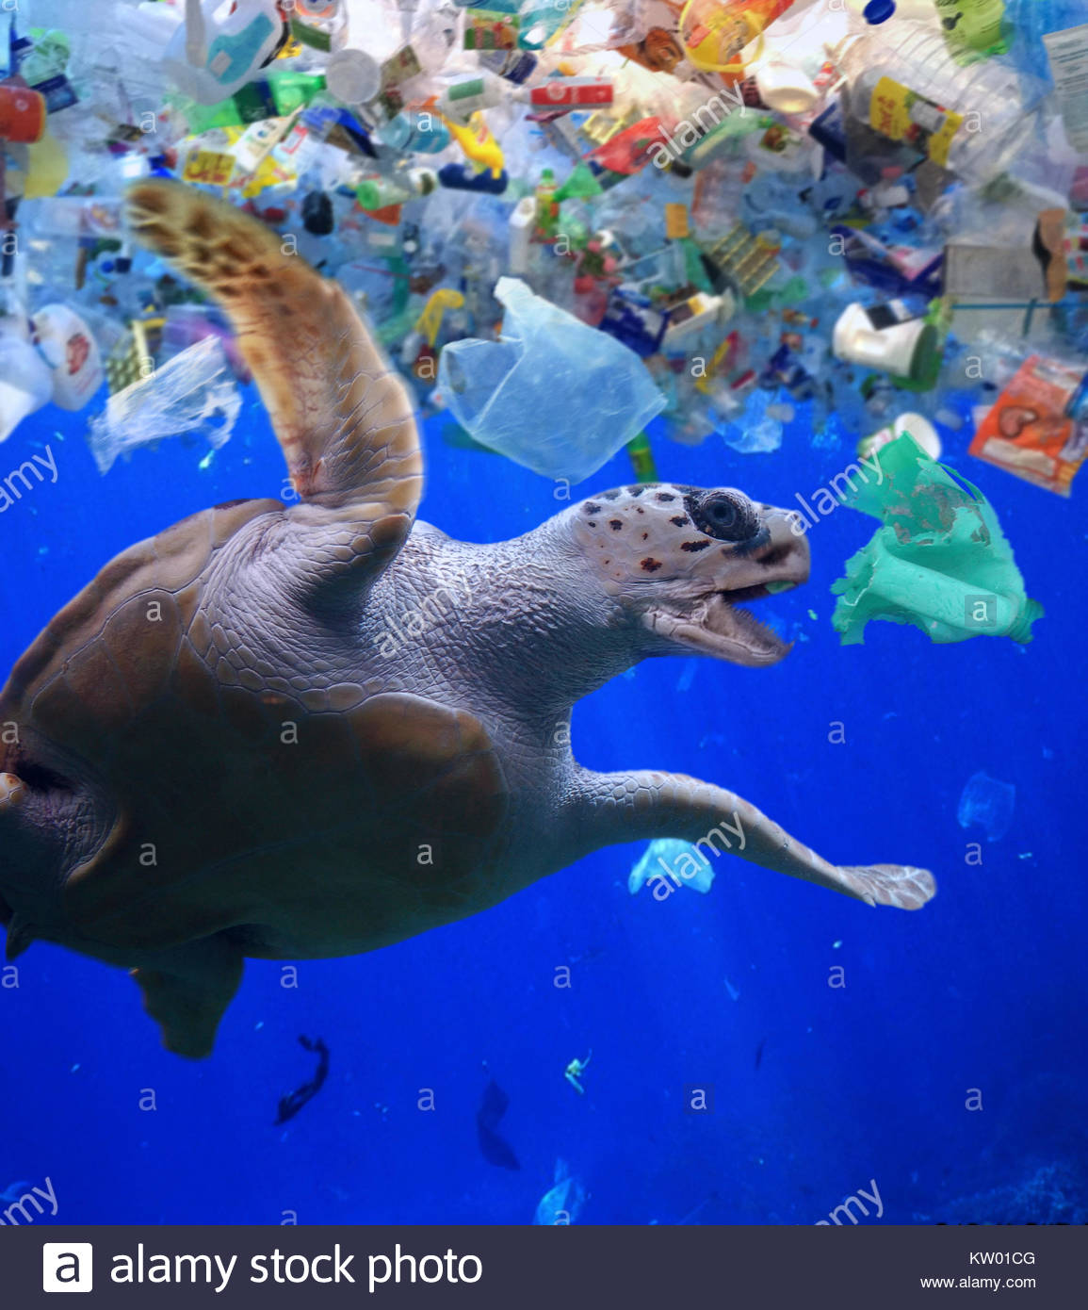
WATER POLLUTION
The causes of water pollution are plastic and toxic waste.
The waste flies into the ocean and fish eat it, then it goes into the food chain and will harm us.
People in many countries drink polluted water because they can not clean it.
Drinking polluted water can cause disease like malaria.
In some rivers and seas, they are filled with toxic waste.

Slide 6
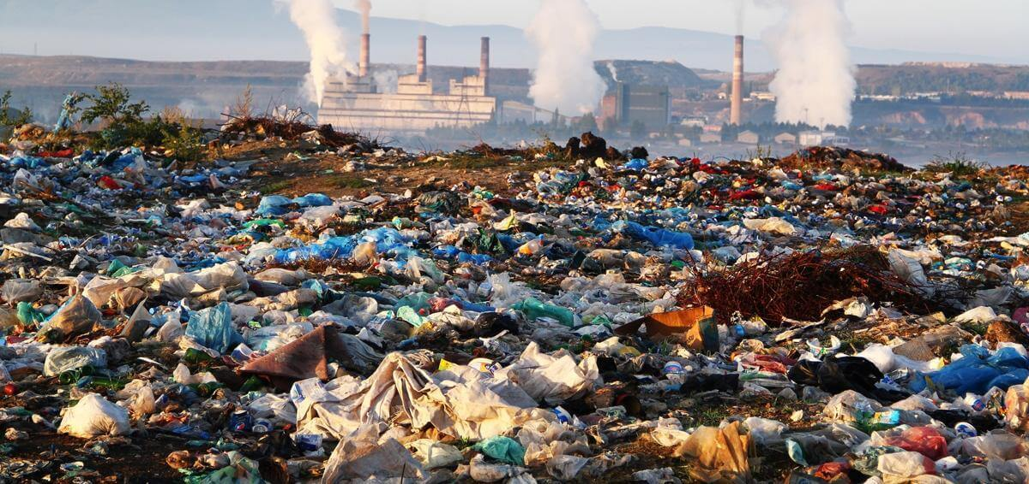
LAND POLLUTION
When we throw away things, they go to a place called landfill.
In landfill it`s filled with lots of waste, to stop this we need to recycle reuse and reduce.
If we don`t stop this, there will be a rubbish mountain.

Slide 7
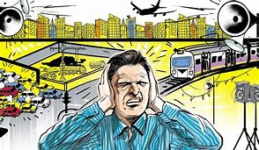
Noise Pollution
Most people don`t know about noise pollution, it is created when there are loud noises.
Noise pollution causes stress, colour blindness and hearing loss.
It is caused by drills ,car horns etc.

Slide 8
Ideas to stop Global Warming
Turn off the tap while brushing
Have less clothes
Don`t use car unless you`re going far
Put solar panels on the roof
Wear sweaters and turn down the heating
Switch off lights when nobody is using them
Reuse paper
Stop using plastic

Slide 9
Reduce, Reuse and Recycle
Thank you
Anish Kandavel

